Slide 1
8086
Addressing Modes

Slide 2
Lecture References:
Book:
Microprocessors and Interfacing: Programming and Hardware, Chapter # 2, Author: Douglas V. Hall
The 8086/8088 Family: Design, Programming, And Interfacing, Chapter # 2, Author: John Uffenbeck.

Slide 3
Addressing Mode and It’s Categories
The different ways in which a microprocessor can access data are referred to as its addressing modes.
Addressing modes of 8086 Microprocessor are categorized as:
Addressing Data
Addressing Program codes in memory
Addressing Stack in memory
Addressing I/O
Implied addressing

Slide 4




Things to know…
□ Instruction format
opcode Operand(s)
□ Instructions can have 1, 2 or no operands
□ INC AX ; 1 operand
CX = CX + DX
ADD CX, DX ; 2 operands
HL^{s}T^{our};^{ce}no operand
□ Instruction cannot have:
Destination
□ SUB [DI], [1234h] ; memory locations as both operands
□ MOV 1234, AX ; immediate data as destination operand

Slide 5
1. Addressing Data
Immediate addressing
Direct addressing
Register [direct] addressing
Register indirect addressing
Base-plus-index addressing
Register relative addressing
Base-relative-plus-index addressing

Slide 6
1. Addressing Data
Immediate addressing
Data is immediately given in the instruction
MOV BL, 44
Immediate addressing transfers the source, an immediate byte, word, doubleword, or quadword of data, into the destination register or memory location. (Example: The MOV AL, 22H instruction copies a byte-sized 22H into register AL.)

Slide 7
Direct addressing
Data address is directly given in the instruction
MOV BX, [437AH]
Direct addressing moves a byte or word between a memory location addressing and a register. The instruction set does not support a memory-tomemory transfer, except with the MOVS instruction.

Slide 8
1. Addressing Data
Register [direct] addressing
Data is in a register (here BX register contains the data) Valid for segment registers also.
MOV AX, BX
MOV AL, BX
Register [indirect] addressing
Register supplies the address of the required data
MOV CX, [BX]

Slide 9
Register [indirect] addressing
Register supplies the address of the required data
MOV CX, [BX]
MOV BX, [CX]
Register indirect addressing transfers a byte or word between a register and a memory location addressed by an index or base register. The index and base registers are BP, BX, DI, and S1. (Example: The MOV AX, [BX] instruction copies the word-sized data from the data segment offset address indexed by BX into register AX.)

Slide 10
1. Addressing Data
Base-plus-index addressing
Base register is either BX or BP
Index register is either DI or SI
MOV DX, [BX+DI]

Slide 11
Register relative addressing
Register can be a base (BX, BP) or an index register (DI, SI)
Mainly suitable to address array data
MOV AX, [BX+1000]
Register relative addressing moves a byte or word between a register and the memory location addressed by an index or base register plus a displacement. (Example: MOV AX,[BX+4] or MOV AX, ARRAY[BX]. The first instruction loads AX from the data segment address formed by BX plus 4. The second instruction loads AX from the data segment memory location in ARRAY plus the contents of BX.)

Slide 12
1. Addressing Data
Base-relative-plus-index addressing
Suitable for array addressing
MOV AX, [BX+DI+10]

Slide 13
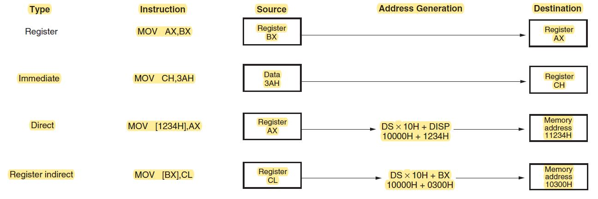

Slide 14
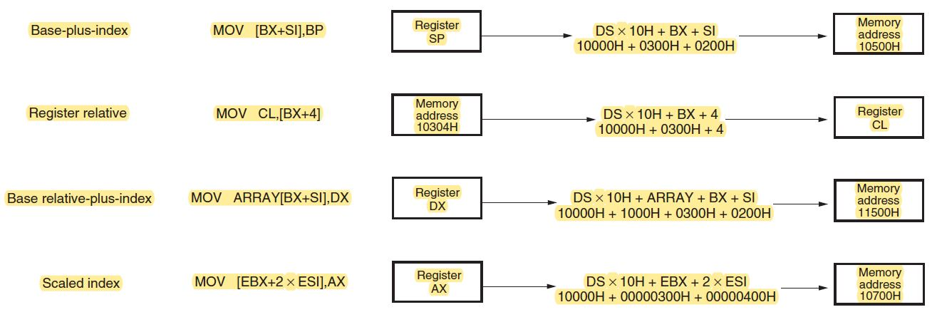

Slide 15
2. Addressing Program Codes in Memory
Used with JMP and CALL instructions
3 distinct forms:
Direct
Indirect
Relative

Slide 16
2. Addressing Program Codes in Memory
Address is directly given in the instruction
JMP 1000: 0000
or JMP doagain ; doagain is a label in code
CALL 1000:0000
or CALL doagain ; doagain is a procedure in code
Often known as far jump or far call

Slide 17
2. Addressing Program Codes in Memory
Address can be obtained from
a) any GP registers (AX,BX,CX,DX,SP,BP,DI,SI)
JMP AX IP = AX ; then CS : IP
b) any relative registers ([BP],[BX],[DI],[SI])
JMP [BX] IP = what is inside the physical address of DS : BX ; then CS:IP
c) any relative register with displacement
JMP [BX+100H] IP = what is inside the physical address of DS : BX +100h ; then CS : IP

Slide 18
3. Addressing Stack in Memory
PUSH and POP instructions are used to move data to and from stack (in particular from stack segment).
PUSH AX POP CX
CALL also uses the stack to hold the return address for procedure.
CALL SUM ; SUM is a procedure name

Slide 19
4. Addressing Input and Output Port
IN and OUT instructions are used to address I/O ports
Could be direct addressing
IN AL, 05h ; Here 05h is a input port number
or indirect addressing
OUT DX, AL ; DX contains the address of I/O port
Only DX register can be used to point a I/O port

Slide 20
5. Implied Addressing
No explicit address is given with the instruction
implied within the instruction itself
Examples:
CLC ; clear carry flag
HLT ; halts the program
RET ; return to DOS

